Slide 1
Evolutionary Computing
Chapter 4
Representation, mutation, recombination

Slide 2
Representation, Mutation, and Recombination
Role of representation and variation operators
Most common representation of genomes:
Binary
Integer
Real-Valued or Floating-Point
Permutation
Tree

Slide 3
Role of representation and variation operators
First stage of building an EA and most difficult one: choose a good representation for the problem
Variation operators: mutation and crossover
Type of variation operators needed depends on chosen representation
TSP problem
What are possible representations?

Slide 4
Two sides of representation
Given some space of phenotypes, i.e., entities that can be solutions to our problem
A representation is:
The genotype space (where to map phenotypes)
The mapping (how is this done)
The term “representation” is often used only for the genotype space, e.g. “binary representation”
This can be specific enough (if we use some standard or otherwise straightforward mapping for that space), or not (if we use some specific mapping into the same space)

Slide 5
Representation (dis)continuity
Example
Phenotypes: positive integers
Genotypes: binary strings
Mapping: the usual binary representation of integers
Problem: phenotypic distance between 7 and 8 is small, but the genotypic distance is big
Solution: other mapping, for instance Gray code, a.k.a. reflected binary code

Slide 6
Strong causality principle
Small alterations in the underlying structure of an object cause small changes in the object’s behaviour.
Small change to the cause —> small change of the effect.
Without this principle no continuity would be ensured in the evolutionary process
Studied in evolution strategies and genetic programming, e.g., Bäck and Schwefel (1993), Rosca and Ballard (1995), but crucial in EC in general

Slide 7
Good representations
Small changes to a genotype induce small changes in the corresponding phenotypes
Lack of this causes discontinuities
Searchability !

Slide 8
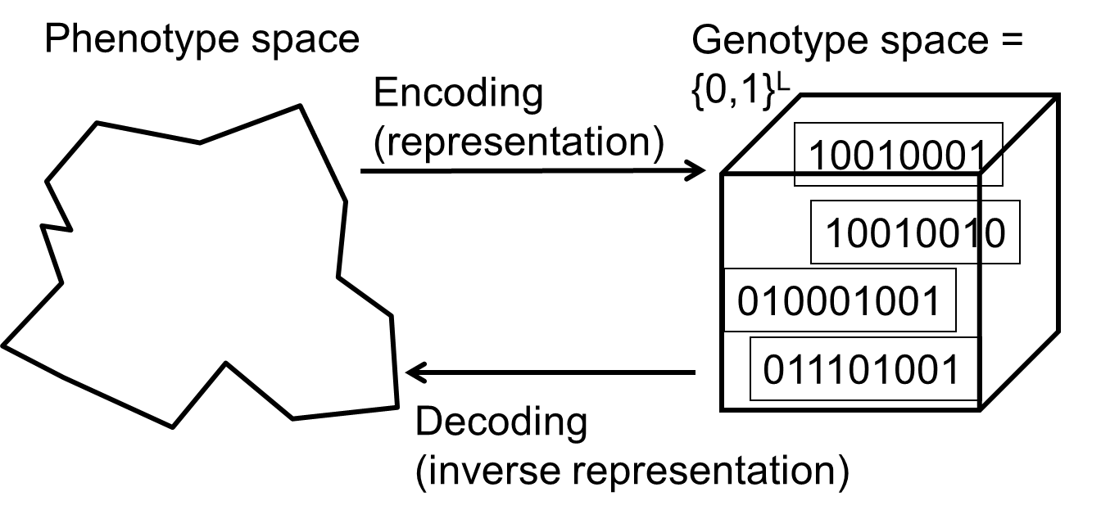
Binary Representation
One of the earliest representations
Genotype consists of a string of binary digits

Slide 9
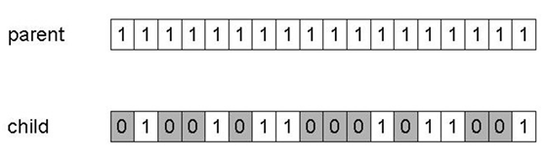
Binary Representation: Mutation
Alter each gene independently with a probability p_{m}
p_{m} is called the mutation rate
Typically between 1/pop_size and 1/ chromosome_length
Mutation can cause variable effect (standard vs. Gray coding)

Slide 10
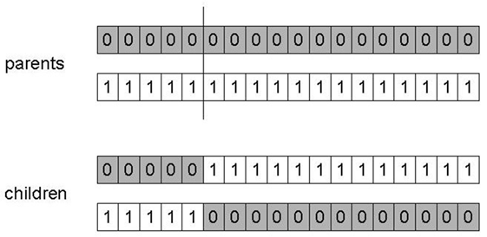
Binary Representation: 1-point crossover
Choose a random point on the two parents
Split parents at this crossover point
Create children by exchanging tails
P_{c} typically in range (0.6, 0.9)

Slide 11
Binary Representation: Alternative Crossovers
Why do we need other crossover(s)?
Performance with 1-point crossover depends on the order that variables occur in the representation
More likely to keep together genes that are near each other
Can never keep together genes from opposite ends of string
This is known as Positional Bias
Can be exploited if we know about the structure of our problem, but this is not usually the case

Slide 12
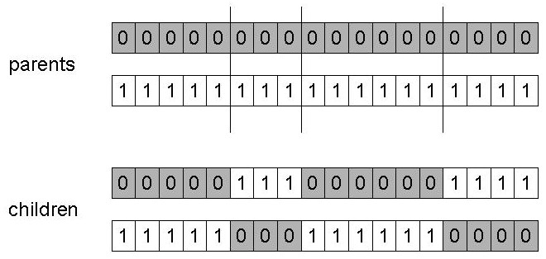
Binary Representation: n-point crossover
Choose n random crossover points
Split along those points
Glue parts, alternating between parents
Generalisation of 1-point (still some positional bias)

Slide 13
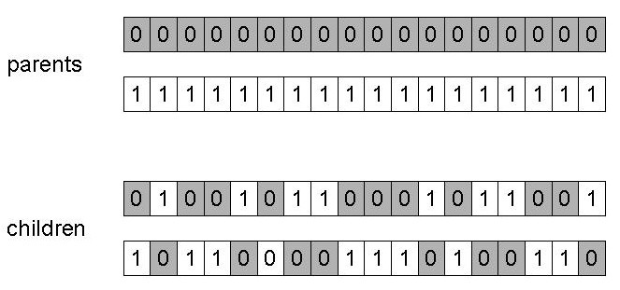
Binary Representation: Uniform crossover
Assign 'heads' to one parent, 'tails' to the other
Flip a coin for each gene of the first child
Make an inverse copy of the gene for the second child
Inheritance is independent of position

Slide 14
Binary Representation: Crossover OR mutation?
Decade long debate: which one is better / necessary / main-background
Answer (at least, rather wide agreement):
it depends on the problem, but
in general, it is good to have both
both have another role
there are mutation-only-EAs (some evolution strategies), as well as xover-only-EAs (some genetic programming)

Slide 15
Binary Representation: Crossover OR mutation?
Exploration: Discovering promising areas in the search space, i.e. gaining information on the problem
Exploitation: Optimising within a promising area, i.e. using information
There is co-operation AND competition between them
Crossover is explorative, it makes a big jump to an area somewhere “in between” two (parent) areas
Mutation is exploitative, it creates random small variations, thereby staying near (in the area of ) the parent

Slide 16
Binary Representation: Crossover OR mutation?
Only crossover can combine information from two parents
Only mutation can introduce new information (new alleles, “fresh blood”)
Crossover does not change the allele frequencies of the population (thought experiment: 50% 0’s on first bit in the population, ?% after performing n crossovers)
To hit the optimum you often need a “lucky” mutation

Slide 17
Integer Representation
Nowadays it is generally accepted that it is better to encode numerical variables directly (integers, floating point variables) instead of encoding them as binaries
Some problems naturally have integer values, e.g. image processing parameters, were you have the natural ordering and notion of distance for numbers
Others take categorical values from a fixed set e.g. {blue, green, yellow, pink}, where you do not have a logical order or distance measure – they are symbols, not numbers
N-point / uniform crossover operators work as previously
Bit-flip mutation can be generalized to random resetting: with probability p_{m} a new value is chosen at random
New options are possible, e.g., we can extend bit-flipping mutation to make a “creep” i.e. more likely to move to similar value (if similar is meaningful by adding a small (positive or negative) value to each allele with probability p.

Slide 18
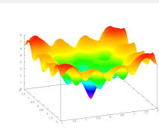
Real-Valued or Floating-Point Representation
Many problems occur as real valued problems, e.g. continuous parameter optimisation f : ℜ ^{n} → ℜ
Illustration: Ackley’s function (often used in EC)

Slide 19
Mapping real values on bit strings
z ∈ [x,y] ⊆ ℜ represented by {a₁,…,a_{L}} ∈ {0,1}^{L} where L is the user defined chromosome length
[x,y] → {0,1}^{L} must be invertible (one phenotype per genotype)
Γ: {0,1}^{L} → [x,y] defines the representation
Only 2^{L} values out of infinite are represented
L determines possible maximum precision of solution
High precision → long chromosomes (slow evolution)

Slide 20
Real-Valued Representation: Uniform Mutation
General scheme of floating point mutations
Uniform Mutation
Analogous to bit-flipping (binary) or random resetting (integers)

Slide 21
Real-Valued Representation: Nonuniform Mutation
Non-uniform mutations:
Many methods proposed, such as time-varying range of change etc.
Most schemes are probabilistic but usually only make a small change to value
Most common method is to add random noise to each variable separately, taken from N(0, σ) Gaussian distribution and then curtail to range
x’_{i} = x_{i} + N(0,σ)
Standard deviation σ is the mutation step size, controls amount of change (2/3 of random drawings will lie in range (- σ to + σ))

Slide 22
Real-Valued Representation: Self-Adaptive Mutation
Step-sizes are included in the genome and undergo variation and selection themselves: ⟨ x₁,…,x_{n}, σ ⟩
Mutation step size is not set by user but coevolves with solutions
Different mutation strategies may be appropriate in different stages of the evolutionary search process.
Q: WHAT WOULD YOU DO?

Slide 23
Real-Valued Representation: Self-Adaptive Mutation
Mutate σ first
Net mutation effect: ⟨ x, σ ⟩ → ⟨ x’, σ’ ⟩
Order is important:
first σ → σ’ (see later how)
then x → x’ = x + N(0,σ’)
Rationale: new ⟨ x’ ,σ’ ⟩ is evaluated twice
Primary: x’ is good if f(x’) is good
Secondary: σ’ is good if the x’ it created is good
Reversing mutation order this would not work

Slide 24
Real-Valued Representation: Uncorrelated mutation with one σ
Chromosomes: ⟨ x₁,…,x_{n}, σ ⟩
σ’ = σ • exp(τ • N(0,1))
x’_{i} = x_{i} + σ’ • N_{i}(0,1)
Typically the learning rate τ ∝ 1/ n^{½}
^{symbol ∝} ^{means “close to”}
And we have a boundary rule σ’ < ε₀ ⇒ σ’ = ε₀

Slide 25
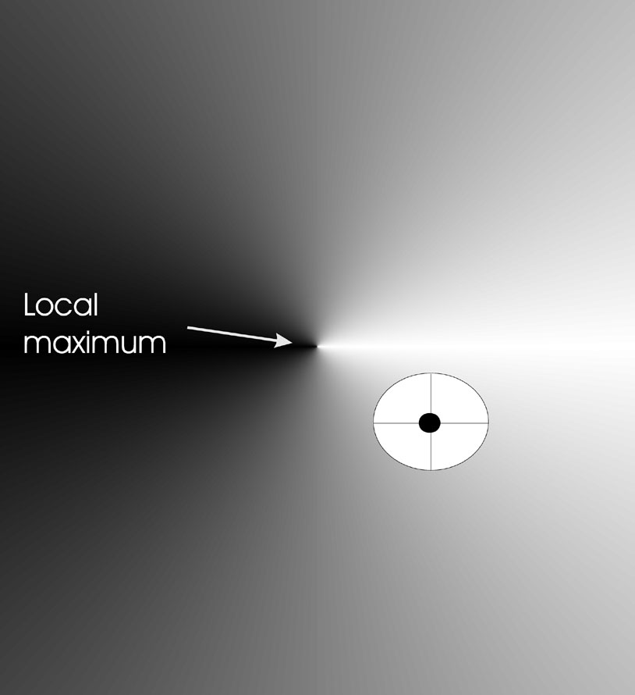
Real-Valued Representation: Uncorrelated mutation with one σ
Mutants with equal likelihood
Circle: mutants having the same chance to be created

Slide 26
Real-Valued Representation: Uncorrelated mutation with n σ’s
Chromosomes: ⟨ x₁,…,x_{n}, σ₁,…, σ_{n} ⟩
σ’_{i} = σ_{i} • exp(τ’ • N(0,1) + τ • N_{i} (0,1))
x’_{i} = x_{i} + σ’_{i} • N_{i} (0,1)
Two learning rate parameters:
τ’ overall learning rate
τ coordinate wise learning rate
τ’ ∝ 1/(2 n)^{½} and τ ∝ 1/(2 n^{½}) ^{½}
Boundary rule: σ_{i}’ < ε₀ ⇒ σ_{i}’ = ε₀

Slide 27
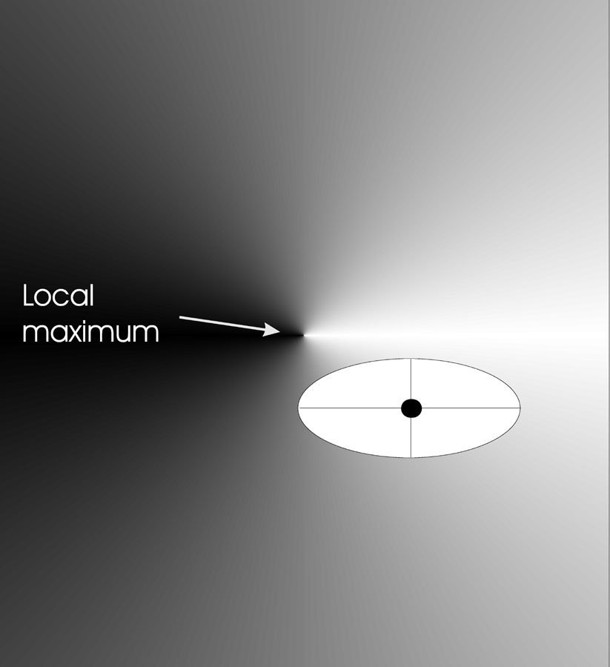
Real-Valued Representation: Uncorrelated mutation with n σ’s
Mutants with equal likelihood
Ellipse: mutants having the same chance to be created

Slide 28
Real-Valued Representation: Correlated mutations
Chromosomes: ⟨ x₁,…,x_{n}, σ₁,…, σ_{n} ,α₁,…, α_{k} ⟩
where k = n • (n-1)/2
Covariance matrix C is defined as:
c_{ii} = σ_{i}²
c_{ij} = 0 if i and j are not correlated
c_{ij} = ½ • ( σ_{i}² - σ_{j}² ) • tan(2 α_{ij}) if i and j are correlated
Note the numbering / indices of the α‘s

Slide 29
Real-Valued Representation: Correlated mutations
The mutation mechanism is then:
σ’_{i} = σ_{i} • exp(τ’ • N(0,1) + τ • N_{i} (0,1))
α’_{j} = α_{j} + β • N (0,1)
x ’ = x + N(0,C’)
x stands for the vector ⟨ x₁,…,x_{n} ⟩
C’ is the covariance matrix C after mutation of the α values
τ ∝ 1/(2 n)^{½} and τ ∝ 1/(2 n^{½}) ^{½} and β ≈ 5°
σ_{i}’ < ε₀ ⇒ σ_{i}’ = ε₀ and
| α’_{j} | > π ⇒ α’_{j} = α’_{j} - 2 π sign(α’_{j})
Note: Covariance Matrix Adaptation Evolution Strategy (CMA-ES) is one of the best EAs for numerical optimisation (open source!)

Slide 30
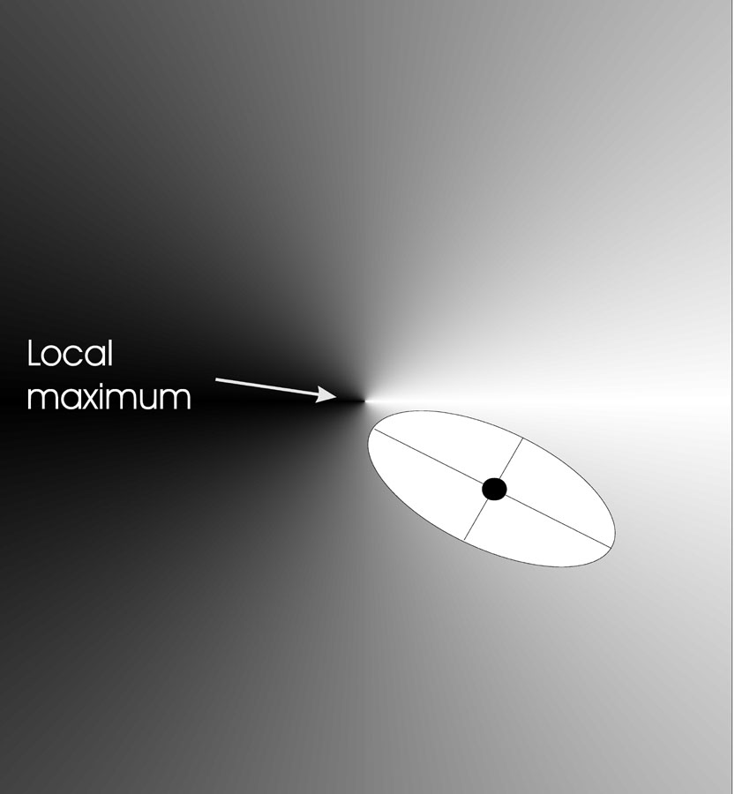
Real-Valued Representation:Correlated mutations
Mutants with equal likelihood
Ellipse: mutants having the same chance to be created

Slide 31
Real-Valued Representation: Recombination
Discrete:
each allele value in offspring z comes from one of its parents (x,y) with equal probability: z_{i} = x_{i} or y_{i}
Could use n-point or uniform
Intermediate
exploits idea of creating children “between” parents (hence a.k.a. arithmetic recombination)
z_{i} = α x_{i} + (1 - α) y_{i} where α : 0 ≤ α ≤ 1.
The parameter α can be:
constant: uniform arithmetical crossover
variable (e.g. depend on the age of the population)
picked at random every time

Slide 32
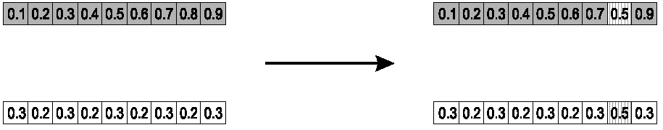
Single arithmetic crossover
Parents: ⟨x₁,…,x_{n} ⟩ and ⟨y₁,…,y_{n}⟩
Pick a single gene (k) at random,
child₁ is:
Reverse for other child. e.g. with α = 0.5

Slide 33
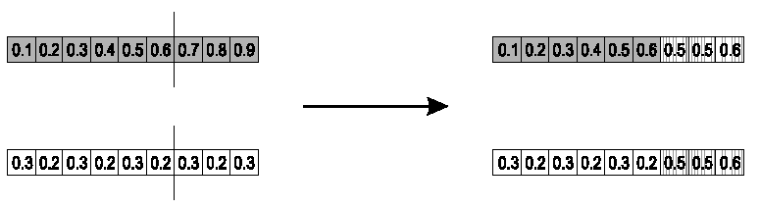
Simple arithmetic crossover
Parents: ⟨x₁,…,x_{n} ⟩ and ⟨y₁,…,y_{n}⟩
Pick a random gene (k) after this point mix values
child₁ is:
reverse for other child. e.g. with α = 0.5

Slide 34
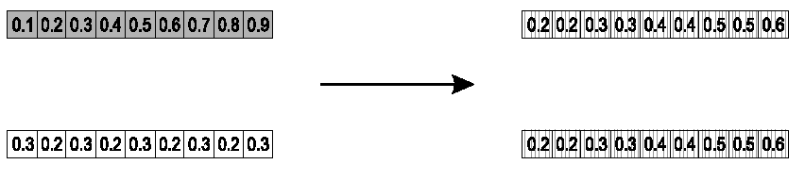
Whole arithmetic crossover
Most commonly used
Parents: ⟨x₁,…,x_{n} ⟩ and ⟨y₁,…,y_{n}⟩
Child₁ is:
reverse for other child. e.g. with α = 0.5

Slide 35
Blend Crossover
Parents: ⟨x₁,…,x_{n} ⟩ and ⟨y₁,…,y_{n}⟩
Assume x_{i} < y_{i}
d_{i} = y_{i} – x_{i}
Random sample z_{i}= [x_{i}, y_{i}]
Random sample z_{i}= [x_{i} – αd_{i}, y_{i} + αd_{i}]
Original authors had best results with α = 0.5

Slide 36
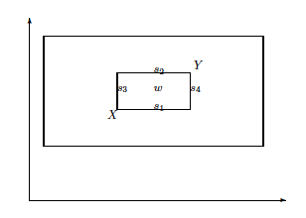
Overview different possible offspring
Single arithmetic: {s₁, s_{2,} s₃, s₄}
Whole arithmetic: inner box (w if alpha = 0.5)
Blend crossover: outer box

Slide 37
Multi-parent recombination
Recall that we are not restricted by the “practicalities” of nature
Noting that mutation uses n = 1 parent, and traditional crossover n = 2, the extension to n > 2 is natural to examine
Been around since 1960s, still rare but studies indicate useful

Slide 38
Multi-parent recombination, type 1
Idea: segment and recombine parents
Example: diagonal crossover for n parents:
Choose n-1 crossover points (same in each parent)
Compose n children from the segments of the parents in along a “diagonal”, wrapping around
This operator generalises 1-point crossover

Slide 39
Multi-parent recombination, type 2
Idea: arithmetical combination of (real valued) alleles
Example: arithmetic crossover for n parents:
i-th allele in child is the average of the parents’ i-th alleles
Creates center of mass as child
Odd in genetic algorithms, long known and used in evolution strategies, called intermediary recombination

Slide 40
QUESTION
What would be the multi-parent equivalent of uniform crossover?
Would that belong to Type 1, Type 2, or a new type?

Slide 41
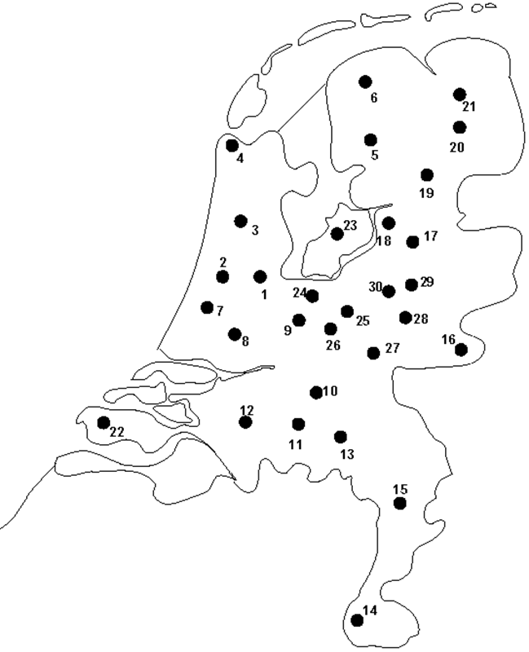
Permutation Representation: TSP example
Problem:
Given n cities
Find a complete tour with minimal length
Encoding:
Label the cities 1, 2, … , n
One complete tour is one permutation (e.g. for n =4 [1,2,3,4], [3,4,2,1] are OK)
Search space is BIG:
for 30 cities there are 30! ≈ 10³² possible tours

Slide 42
Permutation Representations
Ordering/sequencing problems form a special type
Task is (or can be solved by) arranging some objects in a certain order
Example: production scheduling: important thing is which elements are scheduled before others (order)
Example: Travelling Salesman Problem (TSP) : important thing is which elements occur next to each other (adjacency)
These problems are generally expressed as a permutation:
if there are n variables then the representation is as a list of n integers, each of which occurs exactly once

Slide 43
Permutation Representations: Mutation
Normal mutation operators lead to inadmissible solutions
e.g. bit-wise mutation: let gene i have value j
changing to some other value k would mean that k occurred twice and j no longer occurred
Therefore must change at least two values
Mutation parameter now reflects the probability that some operator is applied once to the whole string, rather than individually in each position

Slide 44
Permutation Representations: Swap mutation
Pick two alleles at random and swap their positions

Slide 45
Permutation Representations: Insert Mutation
Pick two allele values at random
Move the second to follow the first, shifting the rest along to accommodate
Note that this preserves most of the order and the adjacency information

Slide 46
Permutation Representations: Scramble mutation
Pick a subset of genes at random
Randomly rearrange the alleles in those positions

Slide 47
Permutation Representations: Inversion mutation
Pick two alleles at random and then invert the substring between them.
Preserves most adjacency information (only breaks two links) but disruptive of order information

Slide 48
Permutation Representations: Crossover
“Normal” crossover operators will often lead to inadmissible solutions
Many specialised operators have been devised which focus on combining order or adjacency information from the two parents
1 2 3 4 5
1 2 3 2 1
5 4 3 2 1
5 4 3 4 5

Slide 49
Permutation Representations: Order 1 crossover
Idea is to preserve relative order that elements occur
Informal procedure:
1. Choose an arbitrary part from the first parent
2. Copy this part to the first child
3. Copy the numbers that are not in the first part, to the first child:
starting right from cut point of the copied part,
using the order of the second parent
and wrapping around at the end
4. Analogous for the second child, with parent roles reversed

Slide 50
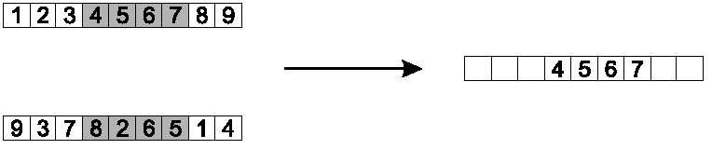
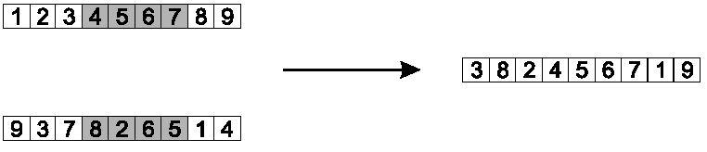
Permutation Representations: Order 1 crossover
Copy randomly selected set from first parent
Copy rest from second parent in order 1,9,3,8,2

Slide 51
Permutation Representations: Partially Mapped Crossover (PMX)
Informal procedure for parents P1 and P2:
Choose random segment and copy it from P1
Starting from the first crossover point look for elements in that segment of P2 that have not been copied
For each of these i look in the offspring to see what element j has been copied in its place from P1
Place i into the position occupied j in P2, since we know that we will not be putting j there (as is already in offspring)
If the place occupied by j in P2 has already been filled in the offspring k, put i in the position occupied by k in P2
Having dealt with the elements from the crossover segment, the rest of the offspring can be filled from P2.
Second child: same procedure with P1 & P2 inverted

Slide 52
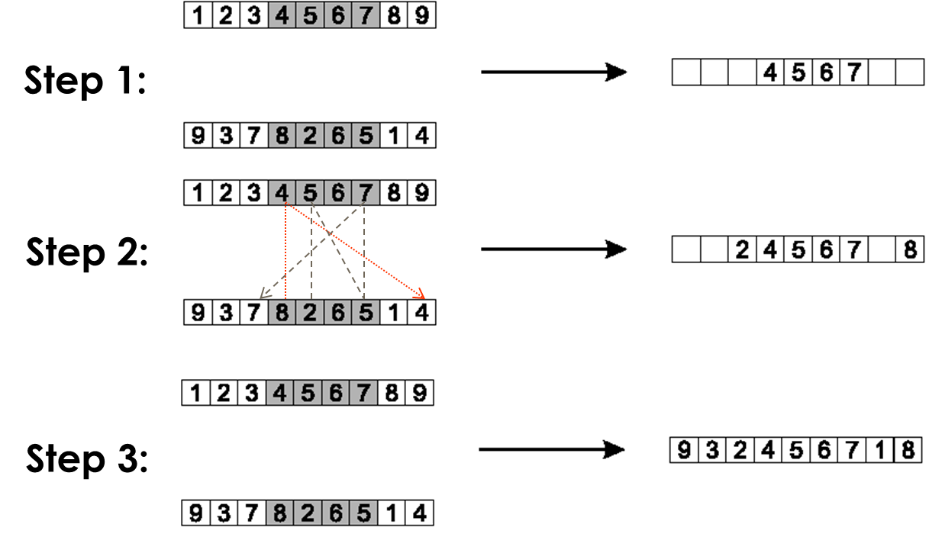
Permutation Representations: Partially Mapped Crossover (PMX)

Slide 53
Permutation Representations: Cycle crossover
Each allele comes from one parent together with its position.
Informal procedure:
1. Make a cycle of alleles from P1 in the following way.
(a) Start with the first allele of P1.
(b) Look at the allele at the same position in P2.
(c) Go to the position with the same allele in P1.
(d) Add this allele to the cycle.
(e) Repeat step b through d until you arrive at the first allele of P1.
2. Put the alleles of the cycle in the first child on the positions they have in the first parent.
3. Take next cycle from second parent

Slide 54

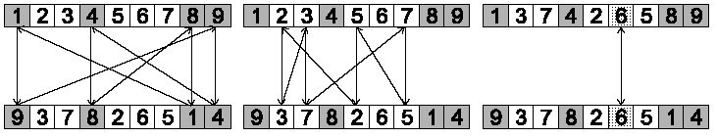
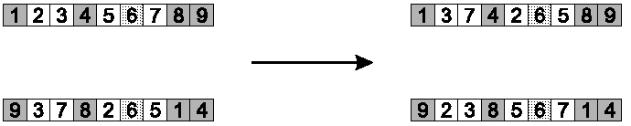
Permutation Representations: Cycle crossover
Step 1: identify cycles
Step 2: copy alternate cycles into offspring

Slide 55
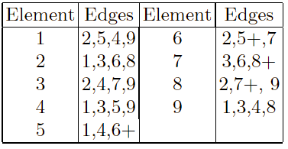
Permutation Representations: Edge Recombination
Works by constructing a table listing which edges are present in the two parents, if an edge is common to both, mark with a +
e.g. [1 2 3 4 5 6 7 8 9] and [9 3 7 8 2 6 5 1 4]

Slide 56
Permutation Representations: Edge Recombination
Informal procedure: once edge table is constructed
Pick an initial element, entry, at random and put it in the offspring
Set the variable current element = entry
Remove all references to current element from the table
Examine list for current element:
If there is a common edge, pick that to be next element
Otherwise pick the entry in the list which itself has the shortest list
Ties are split at random
In the case of reaching an empty list:
a new element is chosen at random

Slide 57
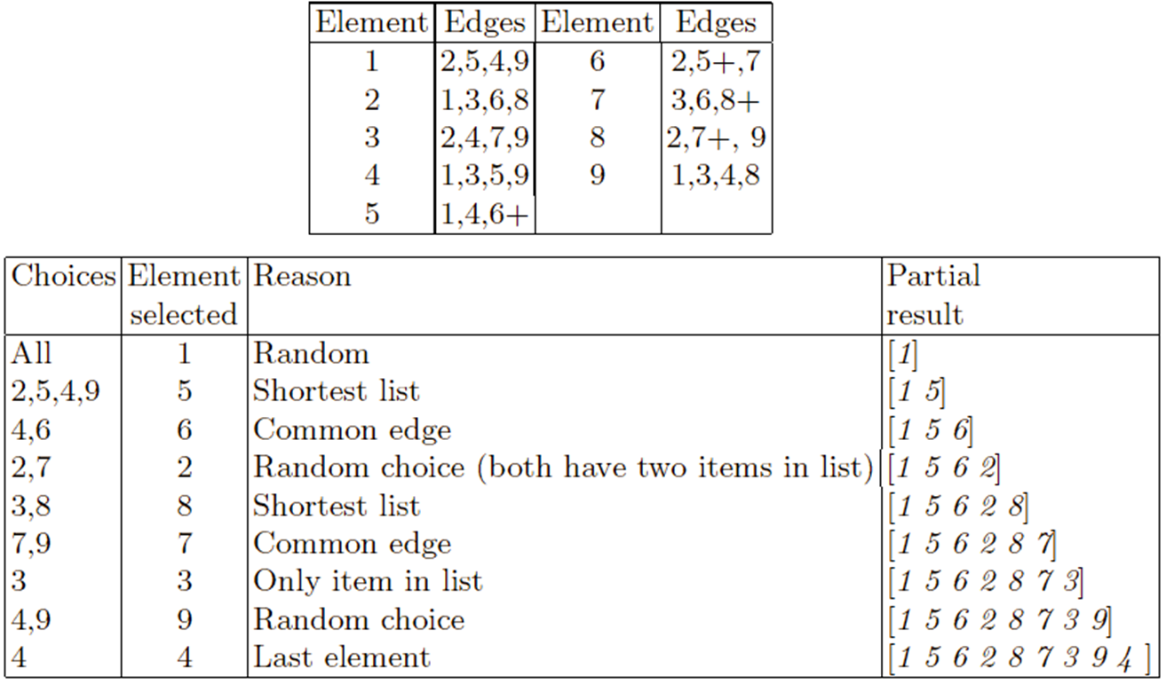
Permutation Representations: Edge Recombination

Slide 58
Tree Representation
Trees are a universal form, e.g. consider
Arithmetic formula:
Logical formula:
Program:
(x ∧ true) → (( x ∨ y ) ∨ (z ↔ (x ∧ y)))
i =1;
while (i < 20)
{
i = i +1
}

Slide 59
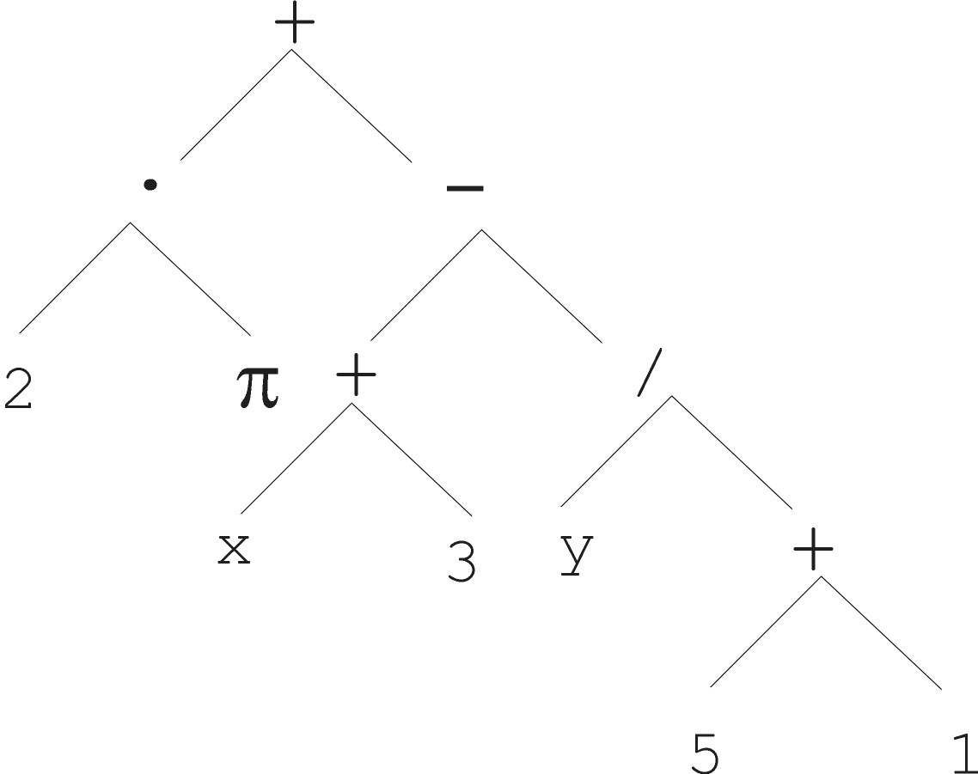
Tree Representation

Slide 60
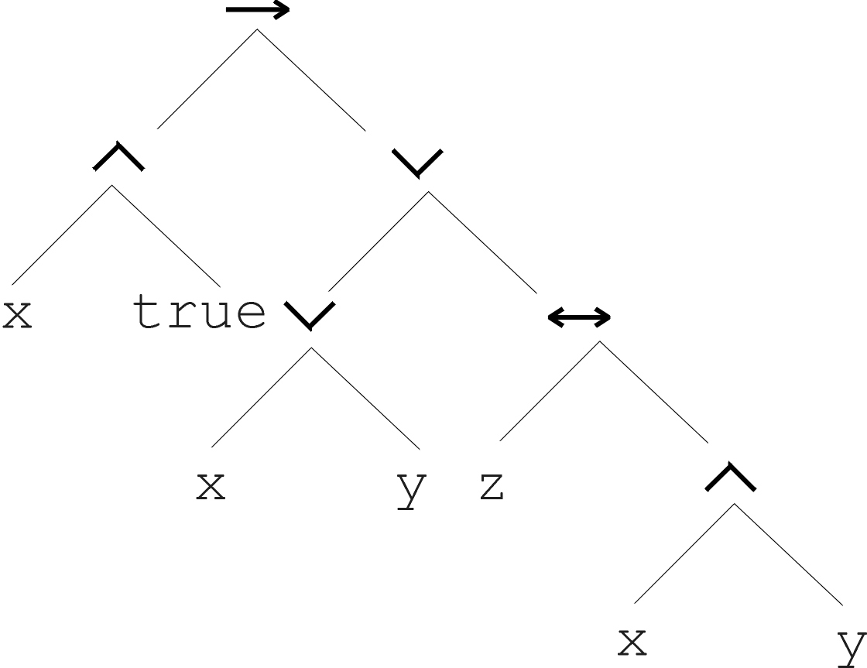
Tree Representation
(x ∧ true) → (( x ∨ y ) ∨ (z ↔ (x ∧ y)))

Slide 61
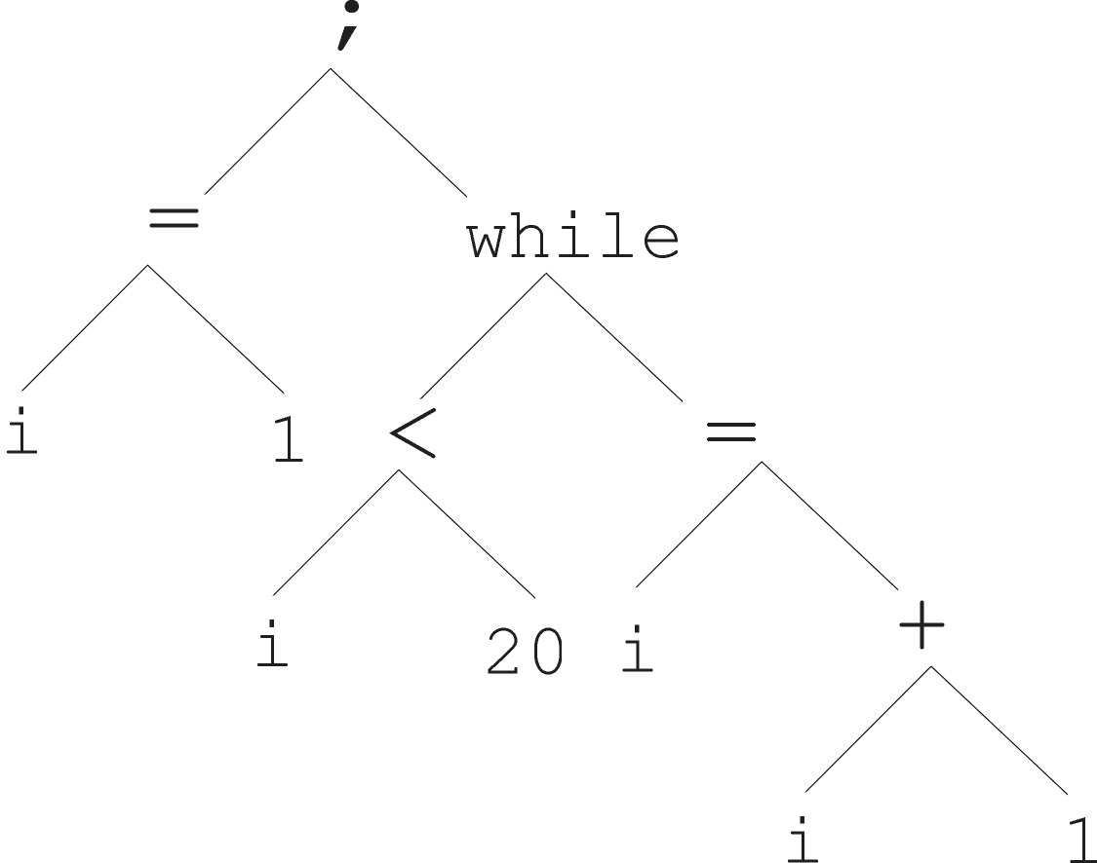
Tree Representation
i =1;
while (i < 20)
{
i = i +1
}

Slide 62
Tree Representation
In GA, ES, EP chromosomes are linear structures (bit strings, integer string, real-valued vectors, permutations)
Tree shaped chromosomes are non-linear structures
In GA, ES, EP the size of the chromosomes is fixed
Trees in GP may vary in depth and width

Slide 63
Tree Representation (6/6)
Symbolic expressions can be defined by
Terminal set T
Function set F (with the arities of function symbols)
Adopting the following general recursive definition:
Every t ∈ T is a correct expression
f(e₁, …, e_{n}) is a correct expression if f ∈ F, arity(f)=n and e₁, …, e_{n} are correct expressions
There are no other forms of correct expressions
In general, expressions in GP are not typed (closure property: any f ∈ F can take any g ∈ F as argument)
Q: Why is condition 3 necessary?

Slide 64
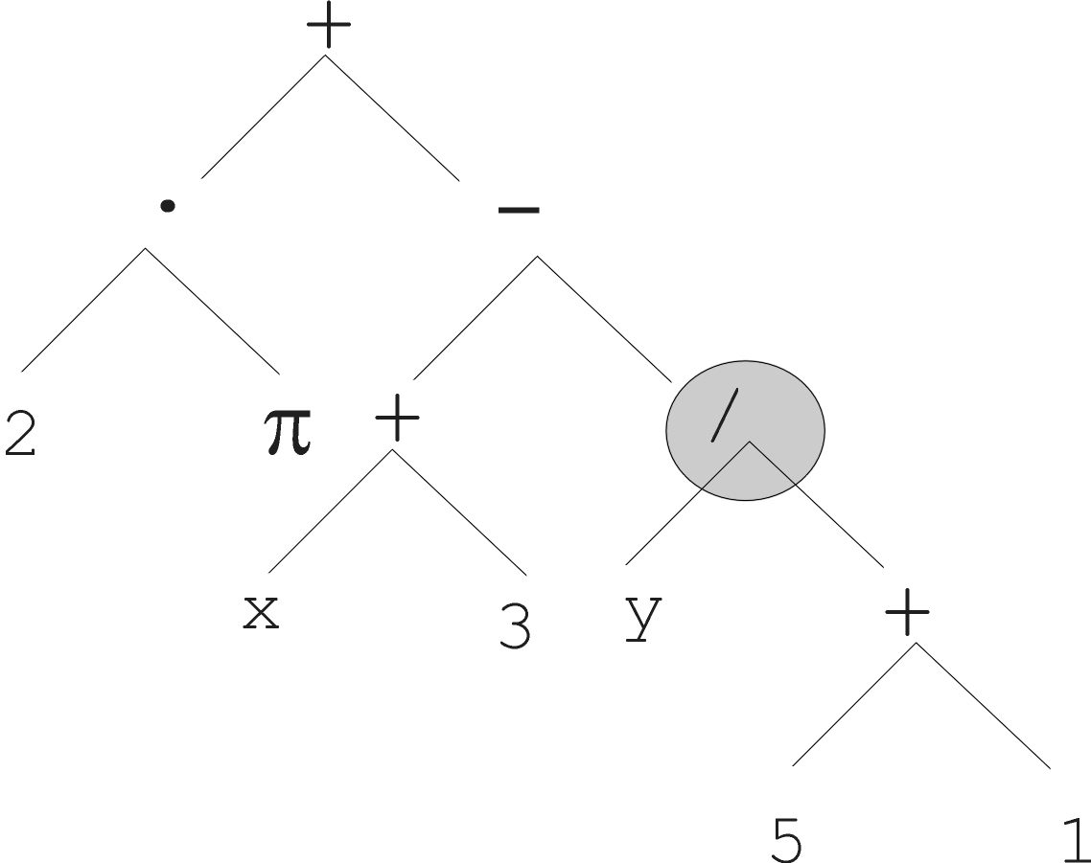
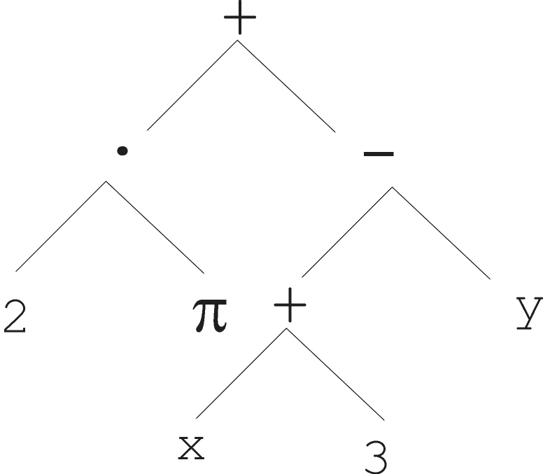
Tree Representation: Mutation
Most common mutation: replace randomly chosen subtree by randomly generated tree

Slide 65
Tree Representation: Mutation
Mutation has two parameters:
Probability p_{m} to choose mutation
Probability to chose an internal point as the root of the subtree to be replaced
Remarkably p_{m} is advised to be 0 (Koza’92) or very small, like 0.05 (Banzhaf et al. ’98)
The size of the child can exceed the size of the parent

Slide 66
Tree Representation: Recombination
Most common recombination: exchange two randomly chosen subtrees among the parents
Recombination has two parameters:
Probability p_{c} to choose recombination
Probability to chose an internal point within each parent as crossover point
The size of offspring can exceed that of the parents

Slide 67
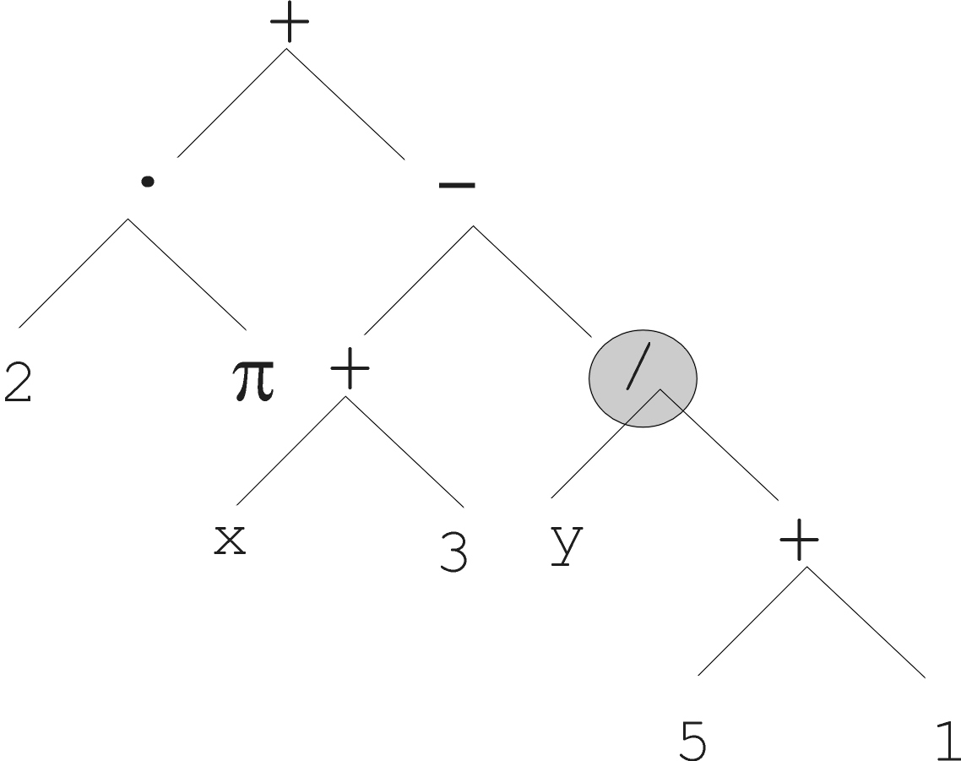
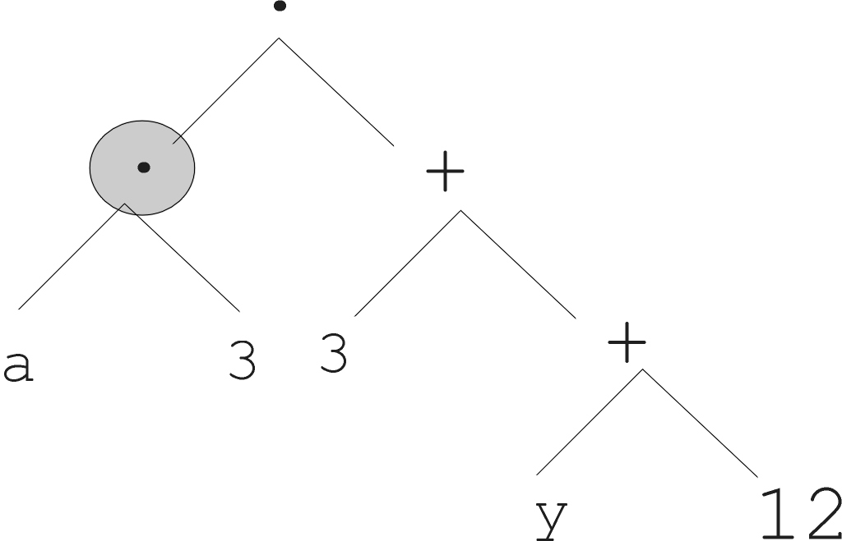
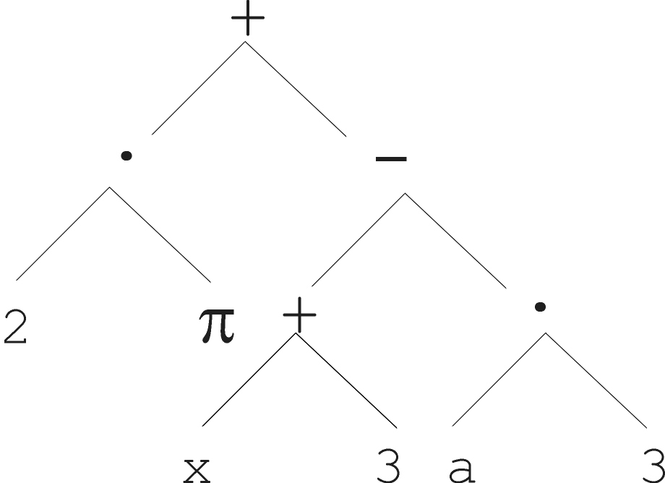
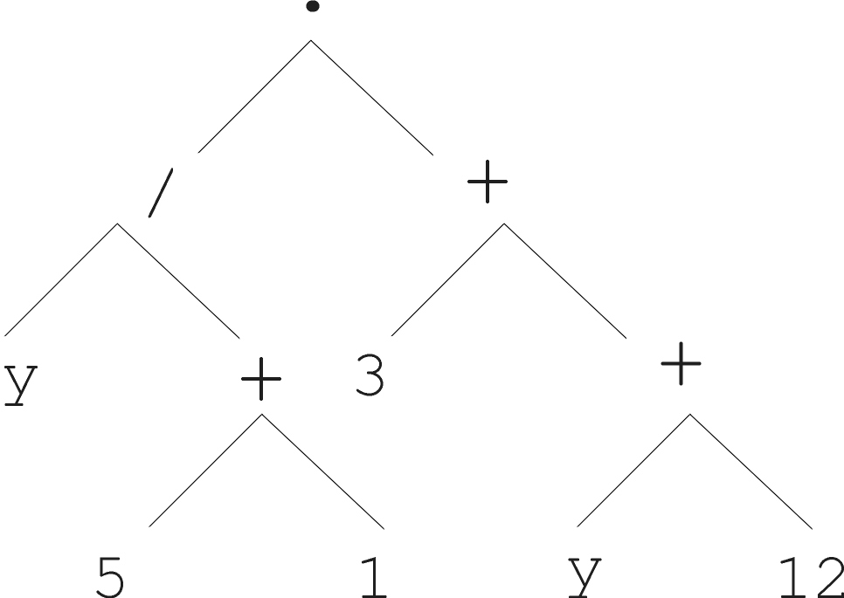
Tree Representation: Recombination
Parent 1
Parent 2
Child 1
Child 2

Slide 68
Important points
Representation is essential when designing an EA
A few data structures are enough to represent many (all?) problems, e.g., binary, integer, real-valued vectors, trees
For any given problem there can be more suitable representations. Some are better than others – remember the strong causality principle !
Reproduction operators must fit the representation
Reproduction operators are stochastic
Reproduction operators can be distinguished by arity
Unary: mutation
Binary: recombination, crossover
N-ary: multi-parent recombination
Self-adaptive mutation is a powerful mechanism. But remember to change the sigma first!

